Slide 1


M.Sc. IT Business Intelligence & Analytics
Name :-Patel Siddharth Rohit bhai
Sem- 4
Project Title :- Facial Expression Detection & Recognition using CNN Enrolment No:- 202327600035

Slide 2
Introduction
This project is about recognizing people’s facial expressions using computer technology. It uses a type of deep learning model called a Convolutional Neural Network (CNN) to look at faces and understand emotions like happy, sad, or angry. The model learns by looking at many pictures of faces with different expressions. Once trained, it can tell how someone feels just by looking at their face. This can be useful in apps like security, games, or healthcare.

Slide 3
Literature Review
Facial expression detection has been a popular research topic in computer vision for many years due to its wide range of applications in psychology, human-computer interaction, and robotics. Convolutional Neural Networks (CNNs) have shown great potential in detecting facial expressions due to their ability to learn complex feature in raw data. In this literature review, we will discuss the state-of-the-art methods in facial expression detection using Deep Learning and CNNs.
In 2020, Jaiswal et al. proposed a CNN based Deep Learning architecture for human emotion detection. In the paper, they present a system which is capable for recognize emotion through facial expressions. The complete system consists of 3 main steps: face detection, feature extraction and emotion classification. The proposed model is evaluated on 2 different datasets Japaness Female Facial Emotion (JAFFE) and Facial emotion recognition challenge (FERC-2013). The proposed model is able to achieve an accuracy of 70.1% and 98.5% on FERC-2013 and JAFFE datasets respectively.

Slide 4
In 2020, Singh et al. demonstrate the classification of Facial Expression Recognition (FER) based on static images using Convolutional Neural Networks (CNNs). In this paper, they have developed hybrid CNN model without any pre-processing or feature extraction. The proposed model is trained on FER2013 dataset and performance of the model in being evaluated on test data where the accuracy comes out to be the 61.2%.
In 2022, Shubhanjay et al. presented a real-time intelligent system for sentiment recognition using single standalone based CNN model. The model proposed in this paper can utilized for different tasks such as face detection, sentiment analysis, and can provide live list of probabilistic labels in real-time from a webcam feed in one blended step. The proposed model outperforms all standalone based models like VGG16, VGG19, and Efficient NetB7 by achieving an accuracy of 75.6% on FER2013 dataset, which is challenging and noisy dataset.

Slide 5
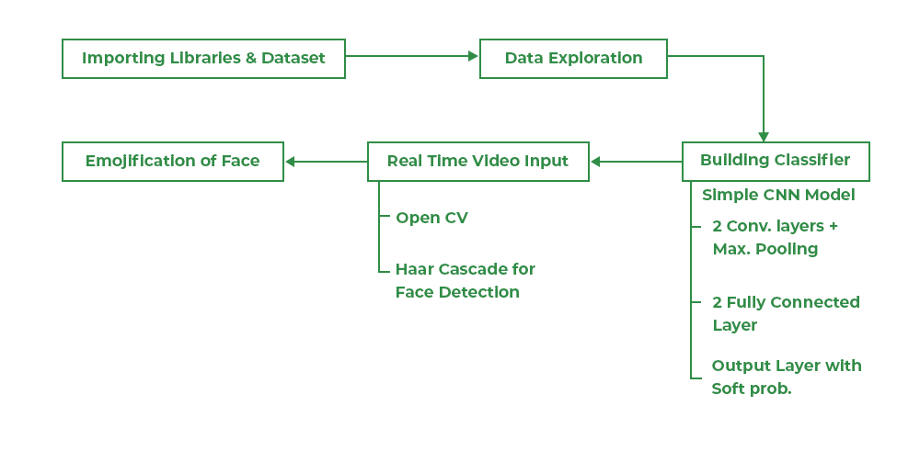
Methodology of Facial Emotion Recognition Using CNN

Slide 6
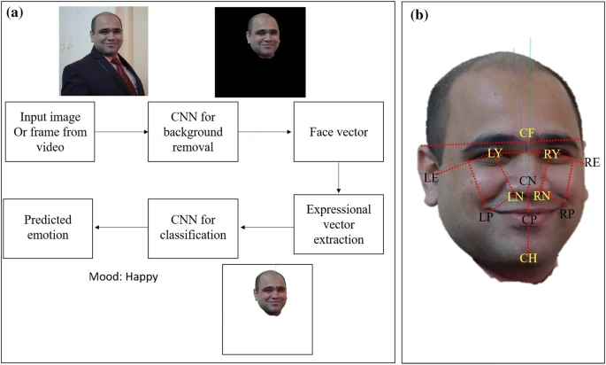
Facial Expression Recognition Pipeline Using Convolutional Neural Networks (CNNs)

Slide 7
(a) Workflow Diagram: Emotion Recognition System
This block diagram outlines the facial emotion recognition pipeline:
The system starts with an input image or video frame.
A CNN removes the background, isolating the face.
A face vector is generated to represent facial features.
Expression-specific features are extracted.
A second CNN classifies these features to detect the emotion.
The final output includes the identified mood (e.g., Happy), along with the face image.
b) Facial Landmark Identification
The 3D model highlights essential facial landmarks used to compute expression vectors:
Forehead: CF (center)
Eyes: LE (left), RE (right)
Cheekbones: LY (left Y-axis), RY (right Y-axis)
Nose: CN (center), LN (left nostril), RN (right nostril)
Mouth: LP (left corner), RP (right corner), CP (center)
Chin: CH

Slide 8
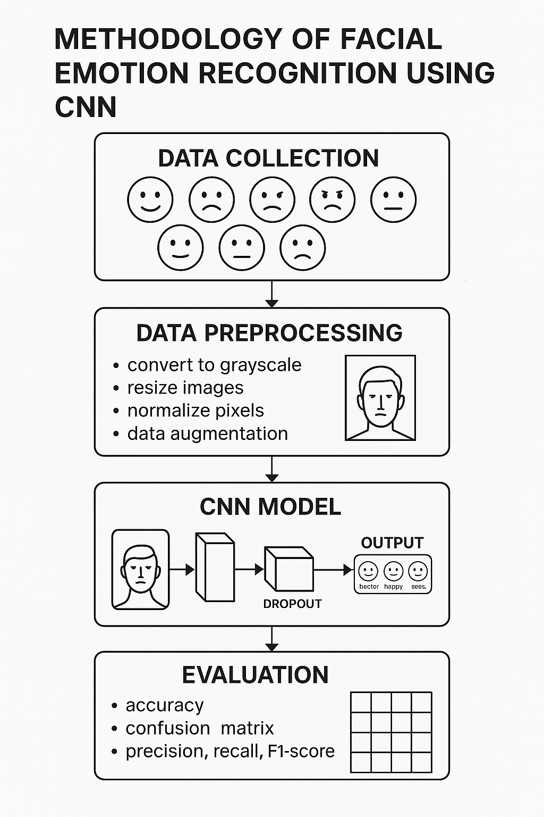
Methodology: A Simple Process Overview

Slide 9
Dataset Description
The FER2013 dataset is a widely used dataset in the field of facial expression detection. It was introduced by Pierre-Luc Carrier and Aaron Courville in their work titled “FER2013: Facial Expression Recognition Challenge” and has since become a benchmark dataset for evaluating facial expression detection and recognition models.
The FER2013 dataset consists of 35,887 grayscale images of size 48x48 pixels. The images are categorized into seven different facial expressions: anger, disgust, fear, neutral, happiness, sadness, and surprise. The dataset is relatively imbalanced with some expression class having a smaller number of samples.

Slide 10
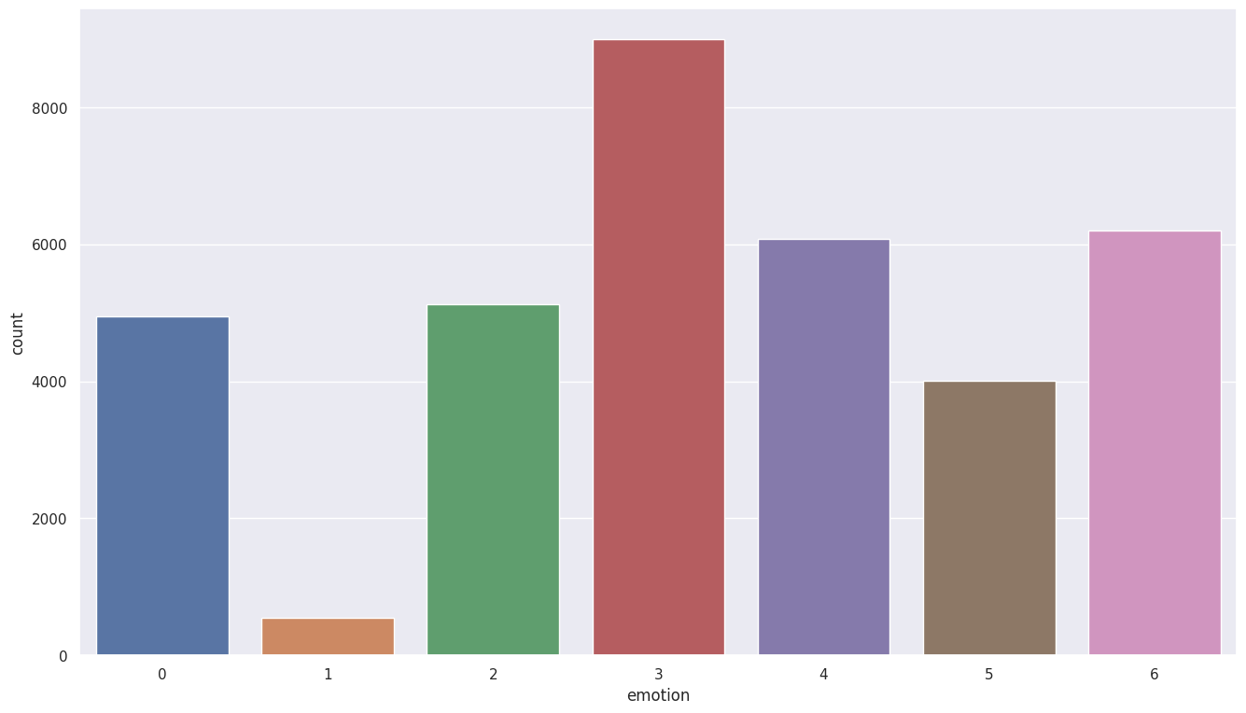
Dataset Exploration and Visualization
From this count plot, we can observe that the dataset is quite imbalanced, as for some emotions we have greater number of images such as happiness and sadness whereas for some emotions we have lesser number of images like disgust and fear.

Slide 11
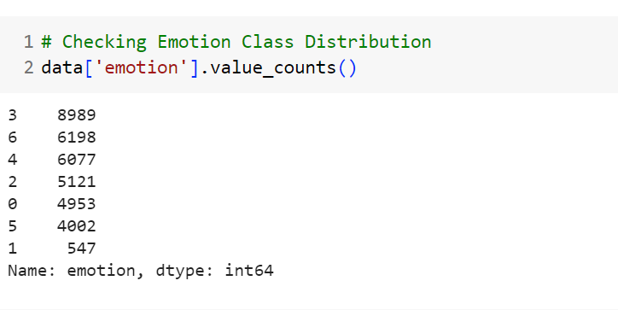
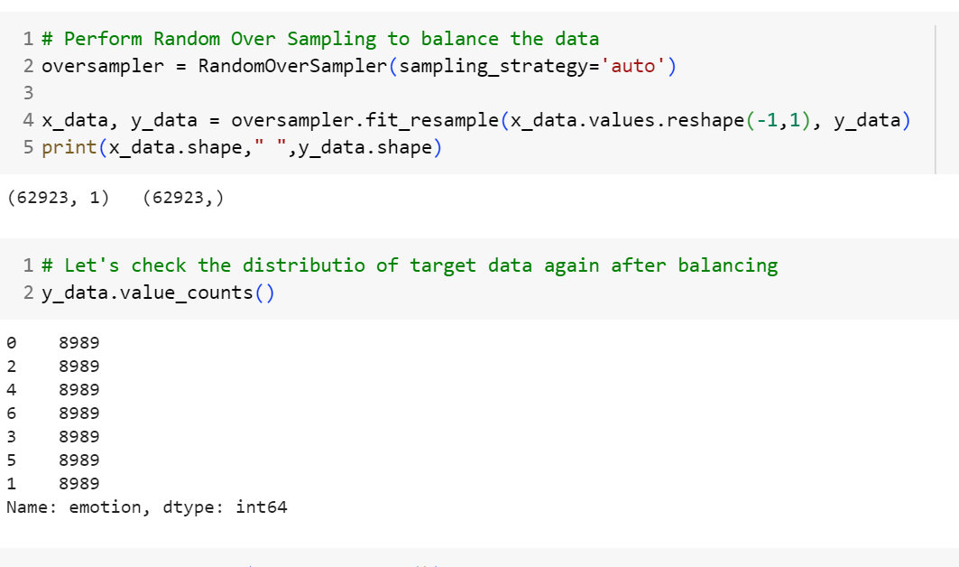
Data Pre-processing
The data is processed using three methods: (I) Balancing the Data, (II) Scaling Images, and (III) One-Hot Encoding. This pre-processing will help in preparation of data and provides additional advantage when detection mechanism is applied.
Balancing the Data: Since the dataset is imbalance, we are using Random Over Sampling technique to balance the data. Random Oversampling is a technique used to address class imbalance in a dataset by artificially increasing the number of minority class. The effect of applying Random Oversampling is depicted in the figure below:

Slide 12
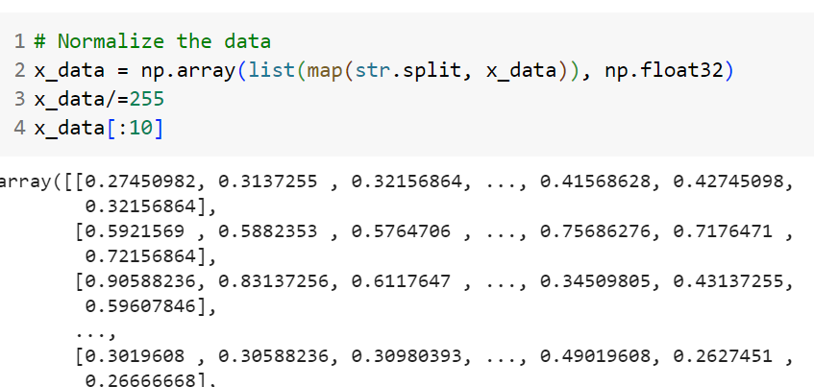
Data Pre-processing
2. Scaling Images: It involves transforming the pixel values of the image to a common scale, typically ranging from 0 to 1. This normalization process ensures that the input data has a consistent range and helps in reducing the impact of varying illumination conditions and enhancing the model’s ability to learn discriminative features.
3. One-Hot Encoding: One-hot encoding is a process that converts categorical variables, such as facial expression labels, binary vector representation. Each class is represented by a binary vector of the same length as the number of classes, where only one element is “hot” (1) and all others are “cold” (0). The hot element indicates the class of the facial expression.

Slide 13
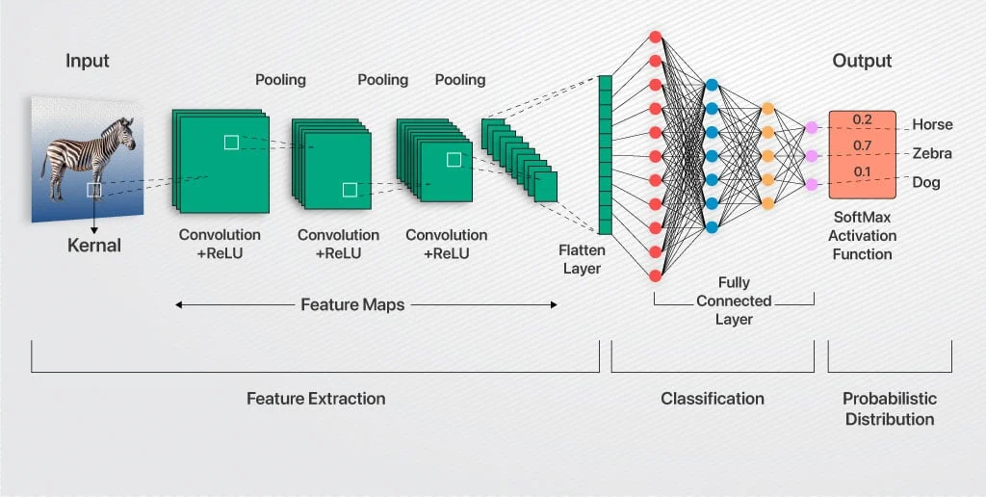
Convolution Neural Networks (CNNs) Architecture for Facial Expression Detection

Slide 14
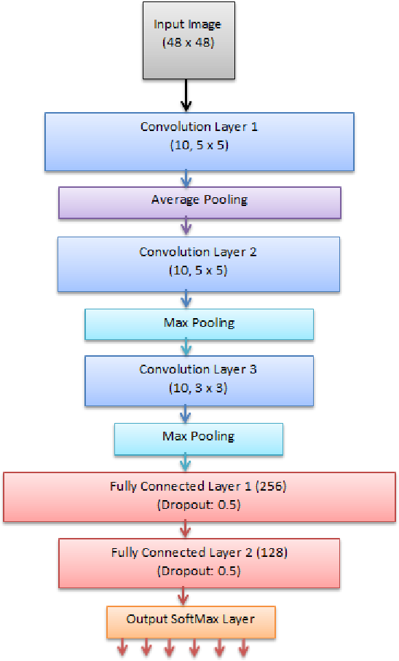
Convolution Neural Networks (CNNs) Architecture for Facial Expression Detection

Slide 15
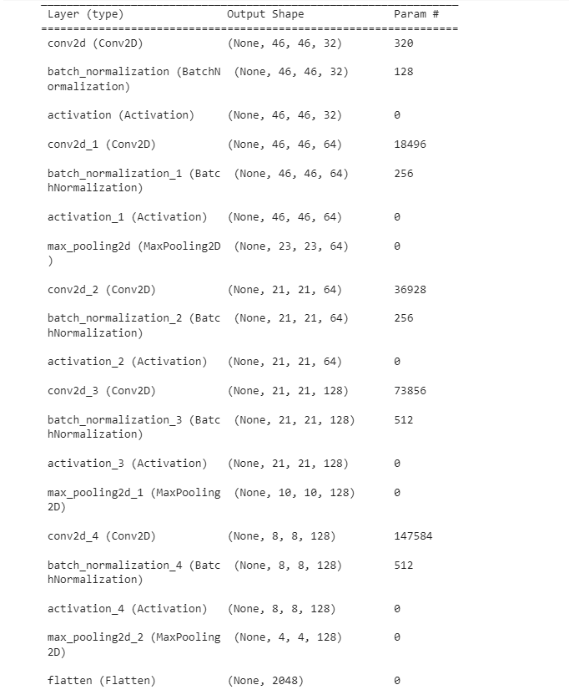
Summary of Proposed CNN Architecture

Slide 16
Performance Metrics
Metric | Score (%) | Definition
Accuracy | 81.39 | Proportion of correctly classified instances over total instances
Precision | 81.20 | True Positives / (True Positives + False Positives)
Recall (Sensitivity) | 82.00 | True Positives / (True Positives + False Negatives)
F1-Score | 81.80 | Harmonic mean of Precision and Recall
Macro Average | Not specified | Average across all classes (equal weight)
Weighted Average | Not specified | Average across all classes (weighted by support)

Slide 17
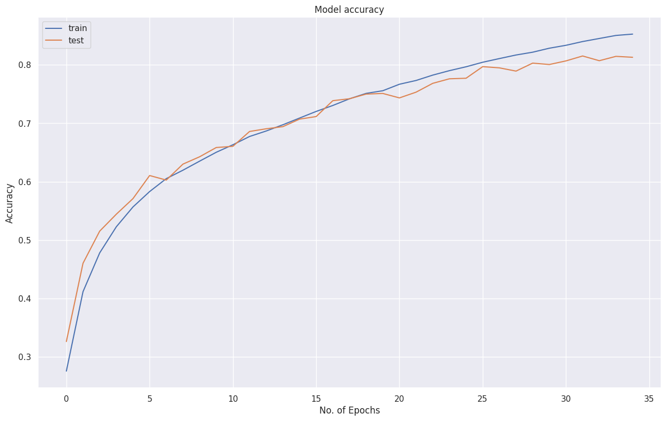
Analysis of Accuracy Graph
The accuracy graph displays the trend of the model’s accuracy on training and validation data over epochs or iterations.
It provides an understanding of how well the model is able to correctly classify facial expressions as the training progresses.
We can observe in our graph that both the training and validation accuracy is improving with no. of epochs and the distance between both the line is very small, which indicates that the model is neither overfitting nor underfitting and the final accuracy score on validation data comes out to be the 81%, which is better than most the existing state-of-the-art results.

Slide 18
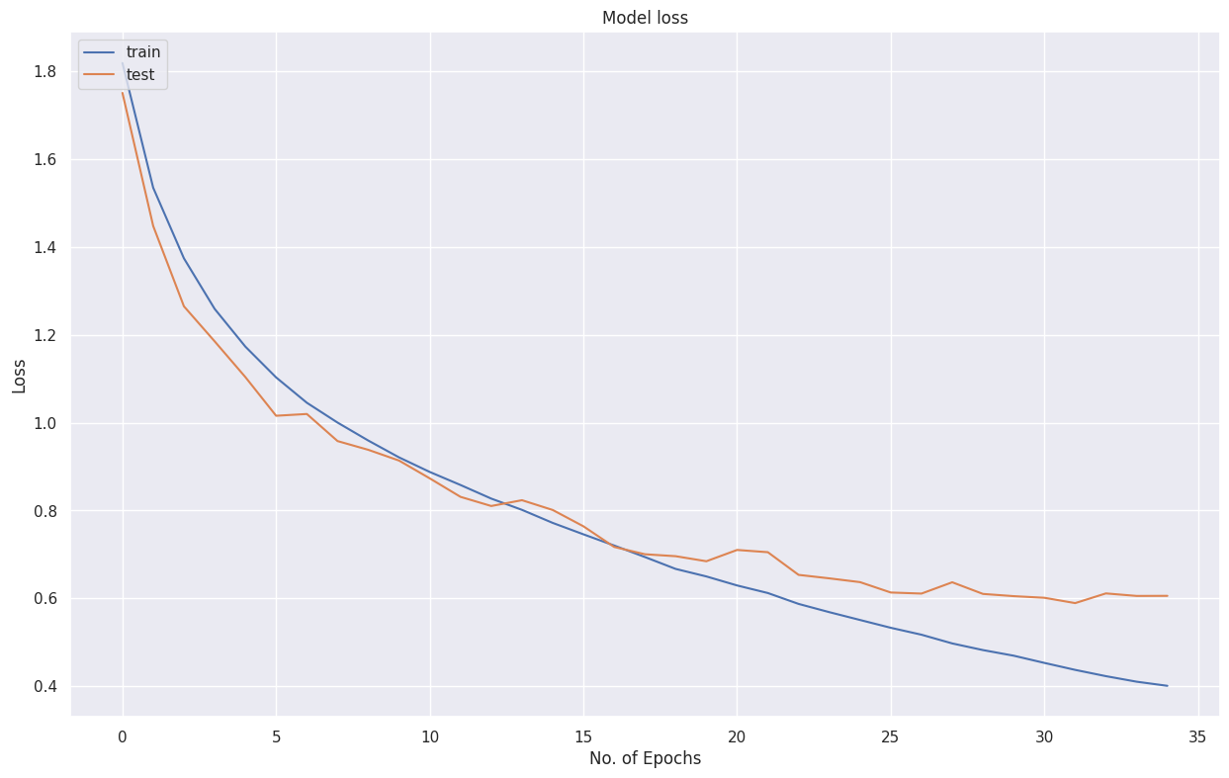
Analysis of Loss Graph
The loss graph illustrates the trend of the model’s loss (e.g., categorical cross-entropy loss) on the training and validation data over epochs or iterations.
It represents how well the model is minimizing the discrepancy between predicted and true class probabilities.
Similar to the accuracy graph, both the training and validation graph decreases initially and reach a stable or minimal value. Final loss on validation data is coming out to be 0.603, which is less than 1 and better than the existing state-of-the-art results.

Slide 19
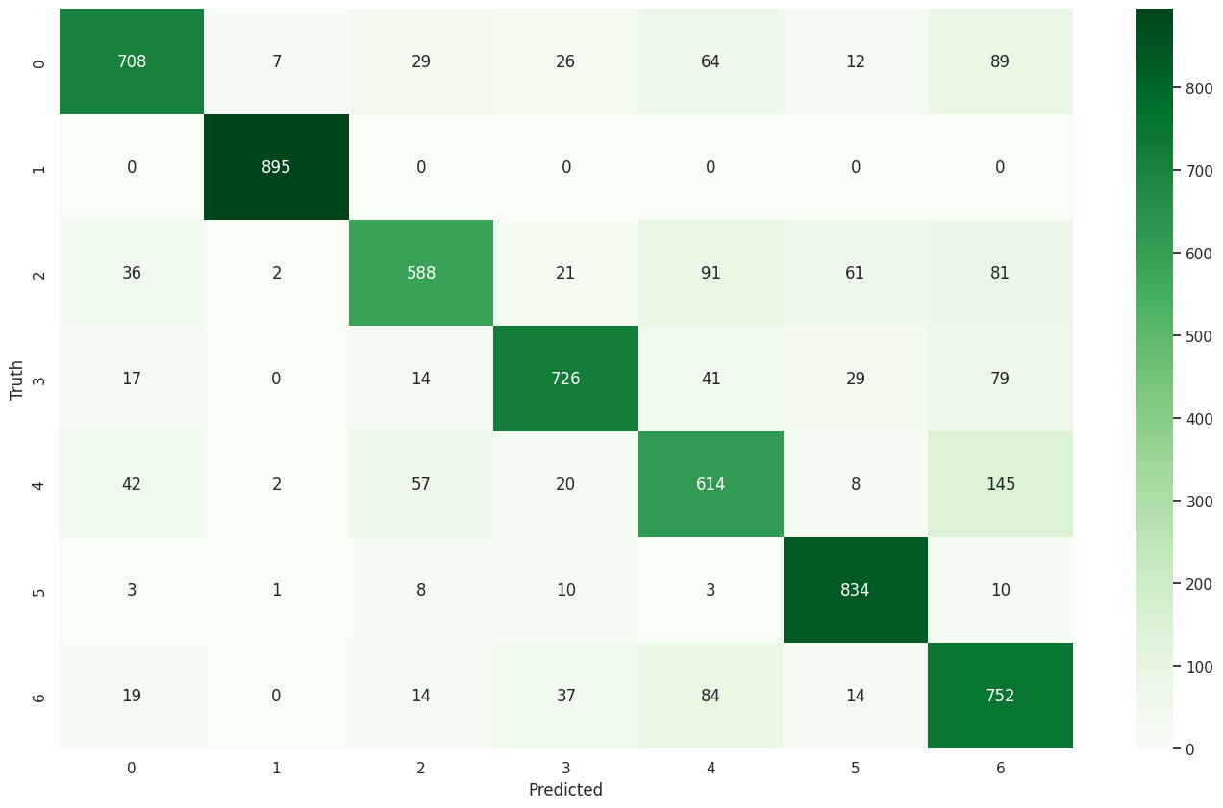
Analysis of Confusion Matrix
Finally, the confusion matrix is plotted that summarizes the performance of a facial expression detection system by displaying the counts of true positives (TP), true negatives (TN), false positives (FP), false negatives (FN) for each emotion class. It is a useful tool which helps in understanding the type of errors made by the classification model.
From the graph, we can observe that maximum corrections we have done for Disgust expression, followed by Angry, Surprise, and Fear class whereas lesser correction for Happiness, Sad, and Neutral. Overall, the confusion matrix provides a comprehensive overview of the model’s predictions and errors for each emotion class, helping identify areas of improvement and guide further optimization efforts.

Slide 20
Uniqueness of Proposed Model
Firstly, Random Over Sampling is performed to balance the dataset. Since, the data is imbalanced I have performed Random Over Sampling to make sure that every class should have equal number of images.
Secondly, I have added Batch Normalization before Activation function which can improve learning speed and stability, reduced internal covariate shift, regularization effect, and allowing the activation function to operate in its linear range. These advantages contribute to more effective and efficient training of deep convolution neural networks.
And lastly, adding a mixture of “valid” and “same” padding in CNNs offers benefits such as efficient resource utilization, control over network capacity, better information flow, robustness to input variations, and diverse feature representations.

Slide 21
Conclusion
In conclusion, this project has explored the use of Convolution Neural Networks (CNNs) for facial expression detection, demonstrating their effectiveness in accurately recognizing and classifying facial expressions. By leveraging the power of deep learning and CNNs, the proposed facial expression detection system has shown promising results in capturing and analysing facial features to predict emotions with high accuracy.
Though extensive experimentation and evaluation, the system achieved significant performance in terms of accuracy and robustness. The model successfully learned discriminative features from facial images and demonstrated its ability to classify various emotions, including happiness, sadness, anger, surprise, disgust, fear and neutral expressions. The utilization of techniques such as data pre-processing, CNN architecture design, and optimization algorithms contributed to the overall success of the system.
In summary, the facial expression detection system based on CNNs has demonstrated its potential in accurately recognizing and classifying facial expressions. Future research can further advance this field by addressing the aforementioned areas, leading to more robust, real-time, and interpretable systems for facial expression analysis.

Slide 22
Results
The CNN model achieved high accuracy in classifying facial expressions like happy, sad, and angry. Real-time recognition using a webcam worked well under good lighting, with smooth and responsive emotion detection.
Discussion
The model performed best on clear emotions like happy and surprised but struggled with similar expressions like fear and disgust. Accuracy dropped in low-light or occluded conditions. Future improvements could include deeper models, better face detection, and more diverse training data.

Slide 23
Paper Link
Jaiswal, S., & Valstar, M. (2016). Deep learning the dynamic appearance and shape of facial action units. https://doi.org/10.1109/wacv.2016.7477625
Li, J., Mi, Y., Li, G., & Ju, Z. (2019). CNN-Based Facial Expression Recognition from Annotated RGB-D Images for Human–Robot Interaction. International Journal of Humanoid Robotics, 16(04), 1941002. https://doi.org/10.1142/s0219843619410020
Singh, S., & Nasoz, F. (2020). Facial Expression Recognition with Convolutional Neural Networks. In 2020 10th Annual Computing and Communication Workshop and Conference (CCWC). https://doi.org/10.1109/ccwc47524.2020.9031283
Begaj, S., Topal, A., & Ali, M. (2020). Emotion Recognition Based on Facial Expressions Using Convolutional Neural Network (CNN). https://doi.org/10.1109/contesa50436.2020.9302866
2017, Zhang et al. proposed a novel CNN architecture Attentional Convolutional Neural Network (ACNN) for facial expression detection. (2018). IEEE.
Facial Emotion Recognition using Deep Learning. (2022, March 10). IEEE Conference Publication | IEEE Xplore. https://ieeexplore.ieee.org/document/9752189

